Slide 1
Innovation Through Security

Slide 2
To empower every person and every organization on the planet to achieve more
Microsoft’s Mission
To help customers to build and run a trusted digital fabric – hybrid and multi-cloud.
Microsoft Security

Slide 3
The Trusted Fabric
Compliance
Risk
Governance
Posture Management
Security Monitoring and Operations
Simplify
Know, Classify,
Protect Resources
Business Value
Great User
Experience
Integrate
Automate
Be Elastic

Slide 4
The Initiatives
Automated and Continuous Governance, Risk and Compliance
Modern Security Operations Center
Simplify
Resource Protection
and Governance
Zero Trust
SecDevOps
Integrate
Automate
Be Elastic

Slide 5
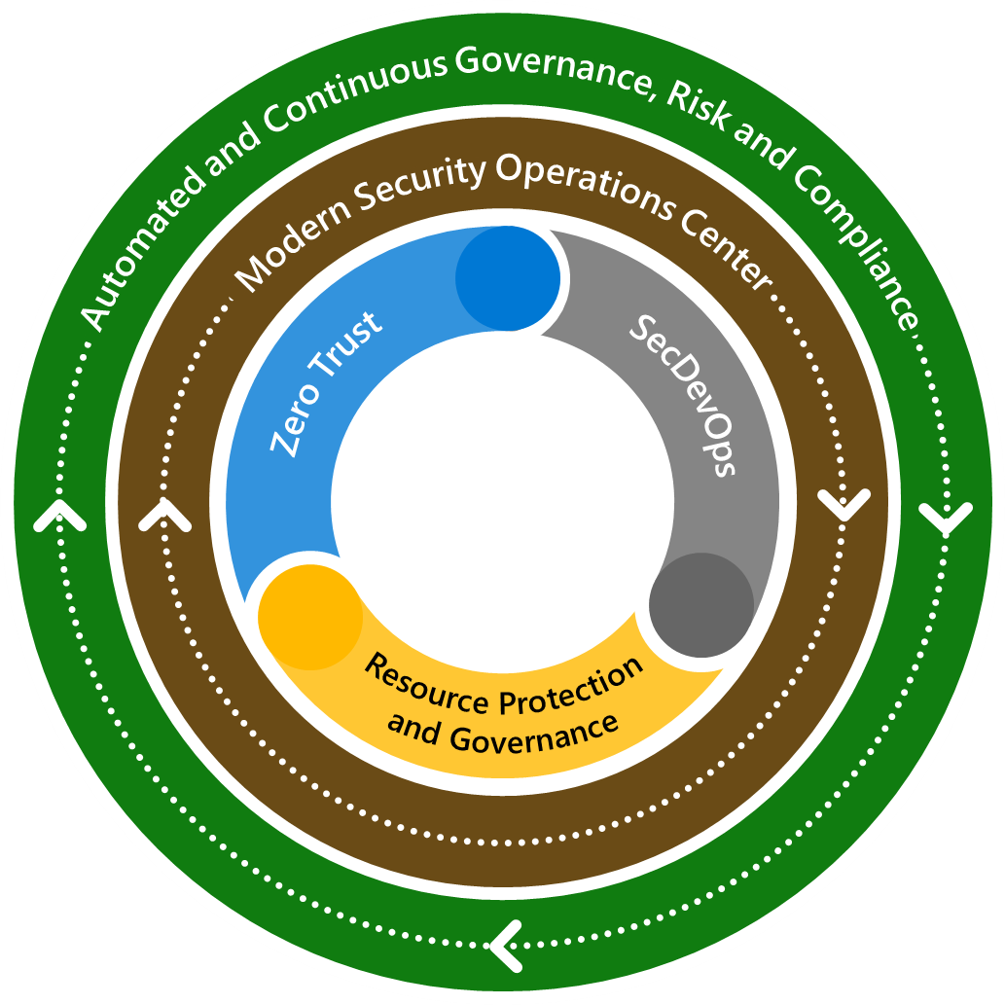
The Outside World
Criminal
Simplify
Hacktivist
Terrorist
Integrate
Automate
Be Elastic
Vandal
Nation State

Slide 6
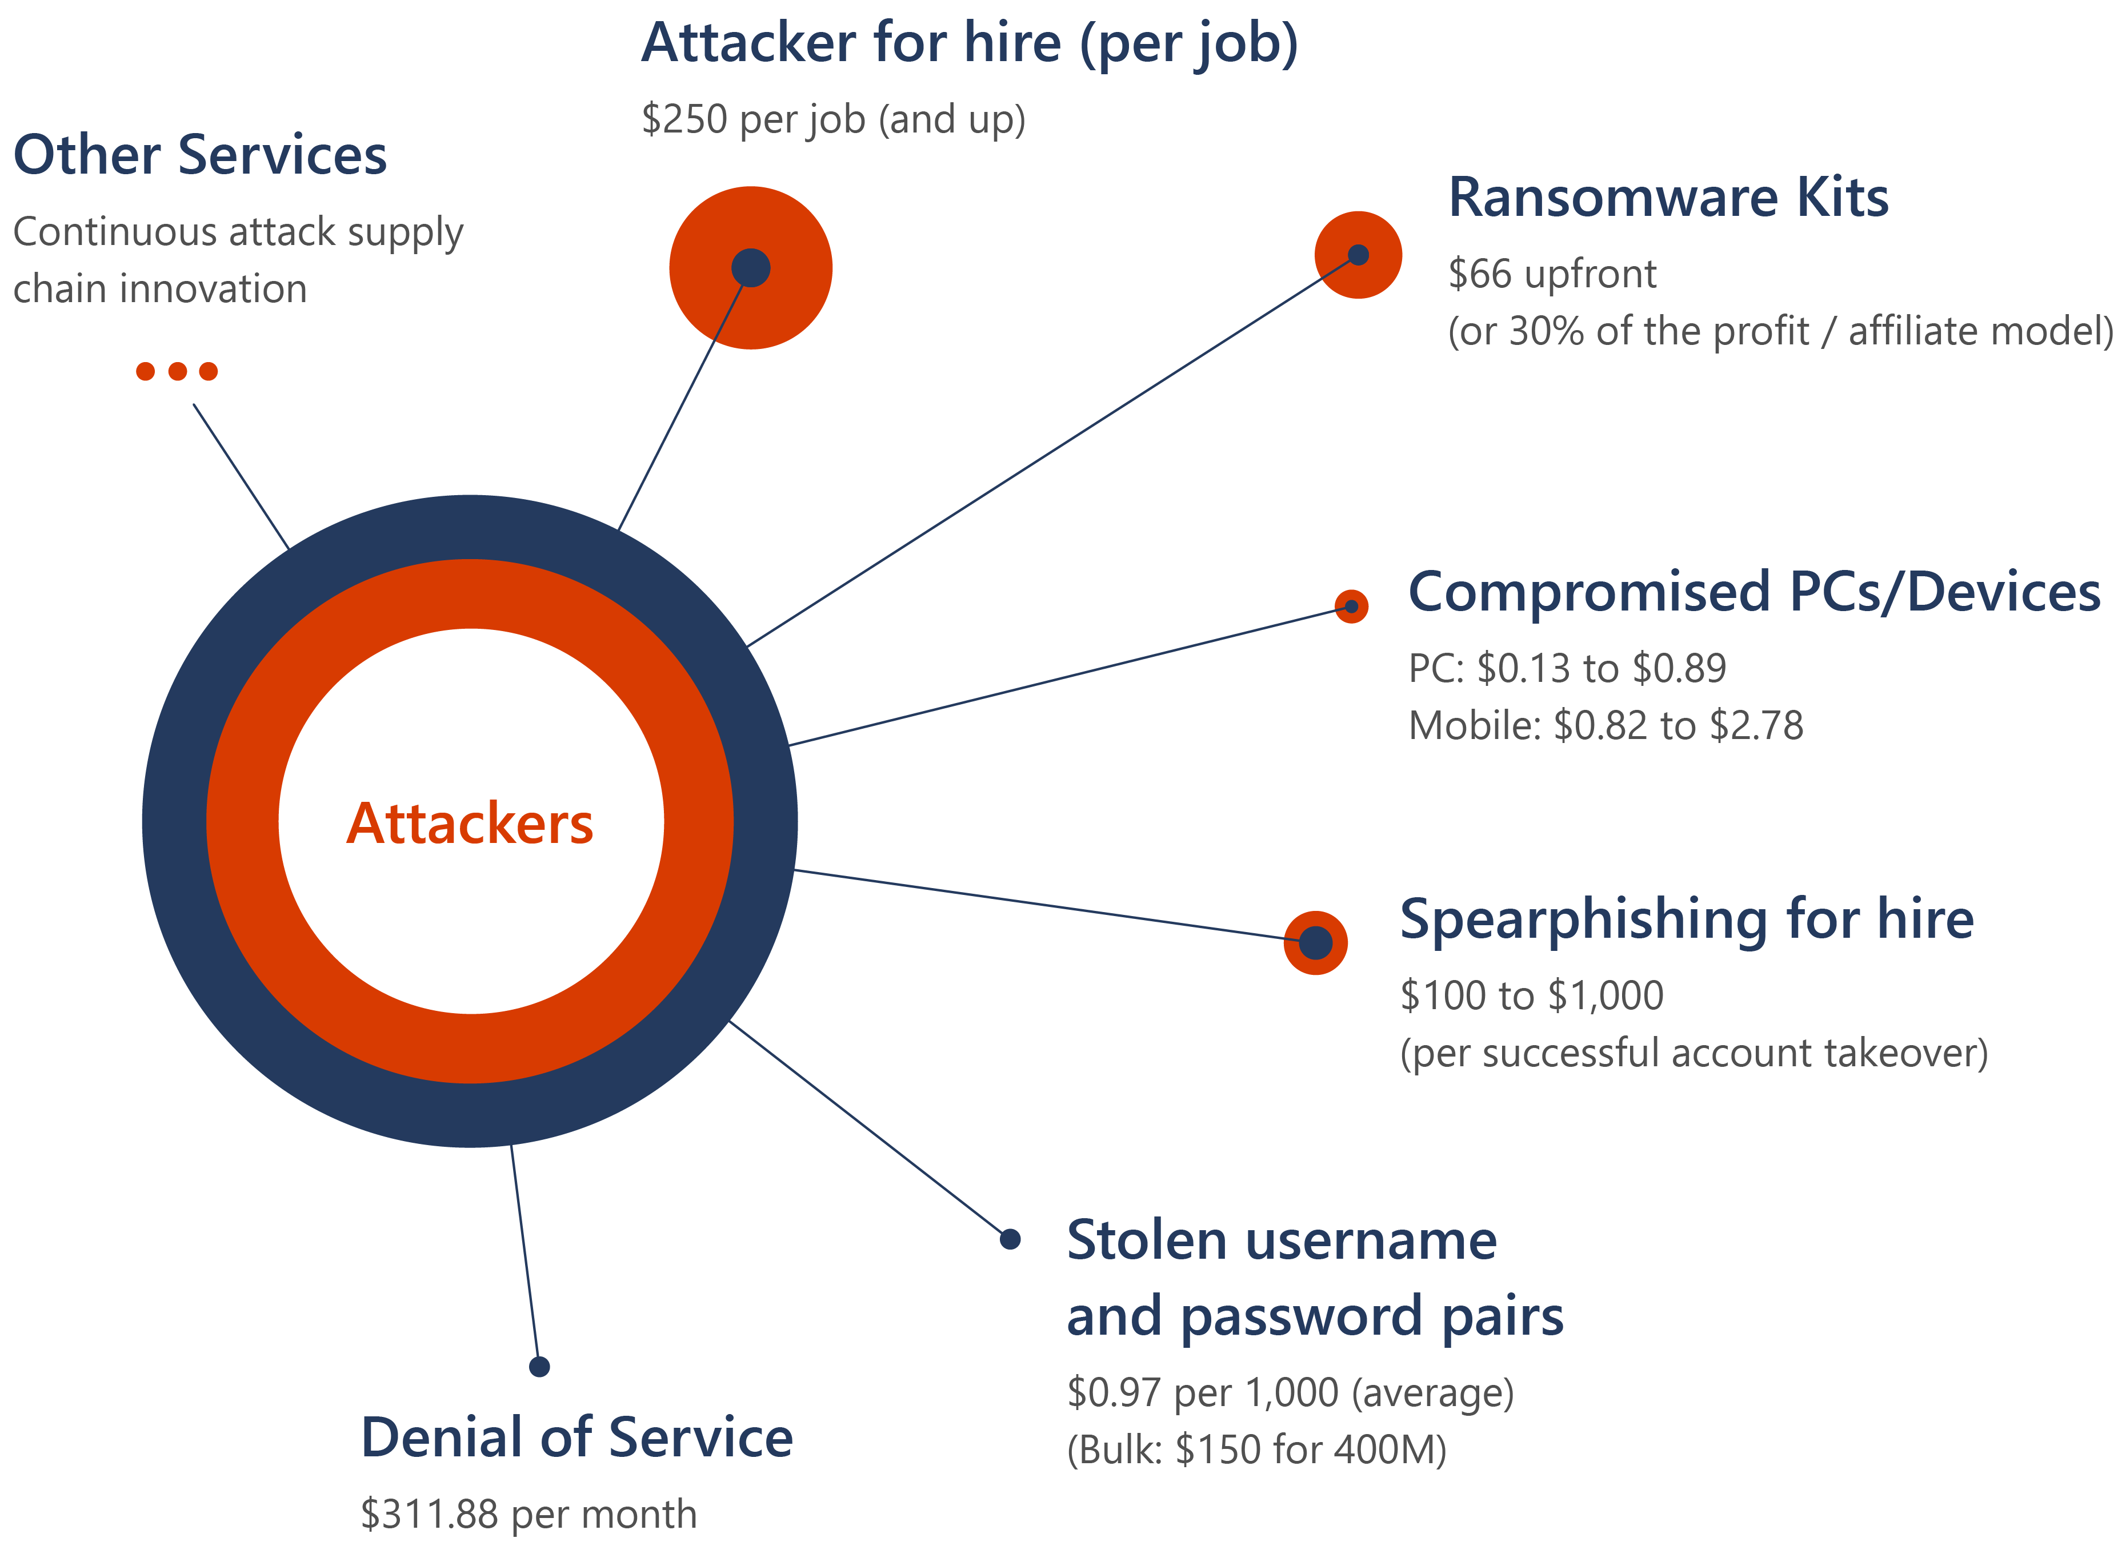
The growing threat of cybercrime
With no technical knowledge of how to conduct a cybercrime attack, an amateur threat actor can purchase a range of services to conduct their attacks with one click.
POSITIVE TRENDS
Transparency: governments and companies coming forward
Priority: new laws, task forces, resources, partnerships
A threat to national security
Cybercriminals attacking all sectors
Ransomware attacks increasingly successful
Cybercrime supply chain continues to mature
The cybercrime economy and services
Notes:
The growing threat of cybercrime
Cybercrime, whether nation state sponsored or permitted, is a threat to national security. Cybercriminals are targeting and attacking all sectors of critical infrastructure, including healthcare and public health, information technology (IT), financial services, and energy sectors. Ransomware attacks are increasingly successful, crippling governments and businesses, and the profits from these attacks are soaring. The cybercrime supply chain, often created by criminal syndicates, continues to mature allowing anyone to buy the services needed to conduct malicious activity for financial gain or other nefarious purpose. Sophisticated cybercriminals are also still working for governments conducting espionage and training in the new battlefield.
It is not hopeless, and there are two positive trends we have seen recently. First, more governments and companies are coming forward when they are victims. This transparency helps in several ways. It has made clear to governments around the world that cybercrime is a threat to security. Victim stories humanize and make clear the consequences of these attacks, drawing attention to the problem and allowing increased engagement from incident responders and law enforcement. Second, now that governments around the world recognize that cybercrime is a threat to national security, they have made combatting it a priority. Governments around the world are passing new laws regarding reporting, creating cross-government task forces, allocating resources, and seeking out private sector assistance.
The cybercrime economy
Through our investigations of online organized crime networks, frontline investigations of customer attacks, security and attack research, nation state threat tracking, and security tool development, we continue to see the cybercrime supply chain consolidate and mature. It used to be that cybercriminals had to develop all the technology for their attacks. Today, they rely on a mature supply chain, where specialists create cybercrime kits and services that other actors buy and incorporate into their campaigns. With the increased demand for these services, an economy of specialized services has surfaced, and threat actors are increasing automation to drive down their costs and increase scale. For example, we are seeing an increasing offer of backconnect proxies (proxies that rotate between mobile, residential, and datacenter systems) in addition to Remote Desktop Protocol (RDP), Secure Shell (SSH), virtual private network (VPN), virtual private server (VPS), web shells, cPanels (webhosting management dashboard), and other anonymization systems.
Other examples include selling compromised credentials that may have been obtained from phishing, scraping botnet logs or other credential harvesting techniques, imposter domain names, phishing-as-a-service, customized lead generation (for example, victims by country, industry, or roles), loads (malicious software used to update malware on an infected computer), denial of service (DoS), and more. As an illustration, in some marketplaces, compromised credentials are offered by different sellers for $1.00 USD to $50.00 USD, depending on a variety of variables including the perceived value of the enterprise target. The number of sites offering services has significantly increased in the past 12 months as well as volume of credentials and variety of phishing kits.
Among the services available to even amateur threat actors are the cryptocurrency escrow services (to ensure services are rendered as offered) that we often see in commodity ransomware campaigns where affiliate models have become firmly established. Nontechnical cybercriminals sign up with a ransomware affiliate where for 30% of the revenue, the affiliate network will supply the ransomware, recovery services, and payment services. The attacker then buys “loads” from a market and pushes the ransomware to the loads they purchased. They then sit back and collect their revenue.
At times there are geographic groups of actors who may offer certain services, but most of these cybercrime markets are global in nature. A buyer in Brazil can obtain phishing kits from a seller in Pakistan, domains from the United States, victim leads from Nigeria, and proxies from Romania.
Not all attacks work. It’s critical that we keep improving our defenses to increase the failure rate of attacks and the associated cost to attackers.

Slide 7
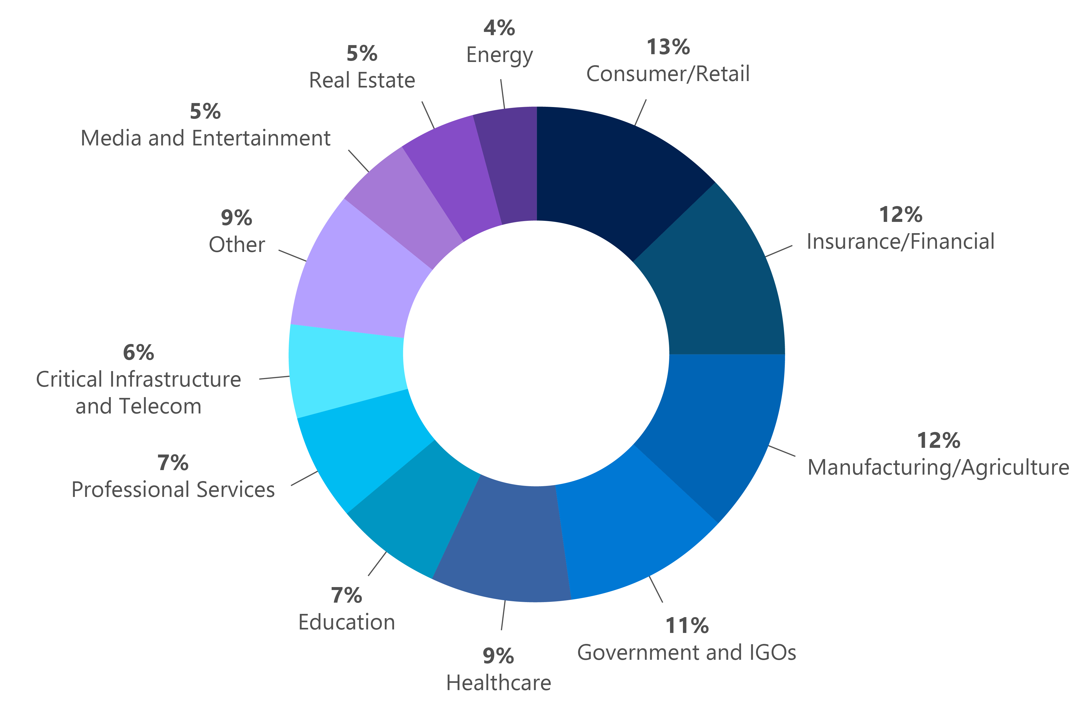
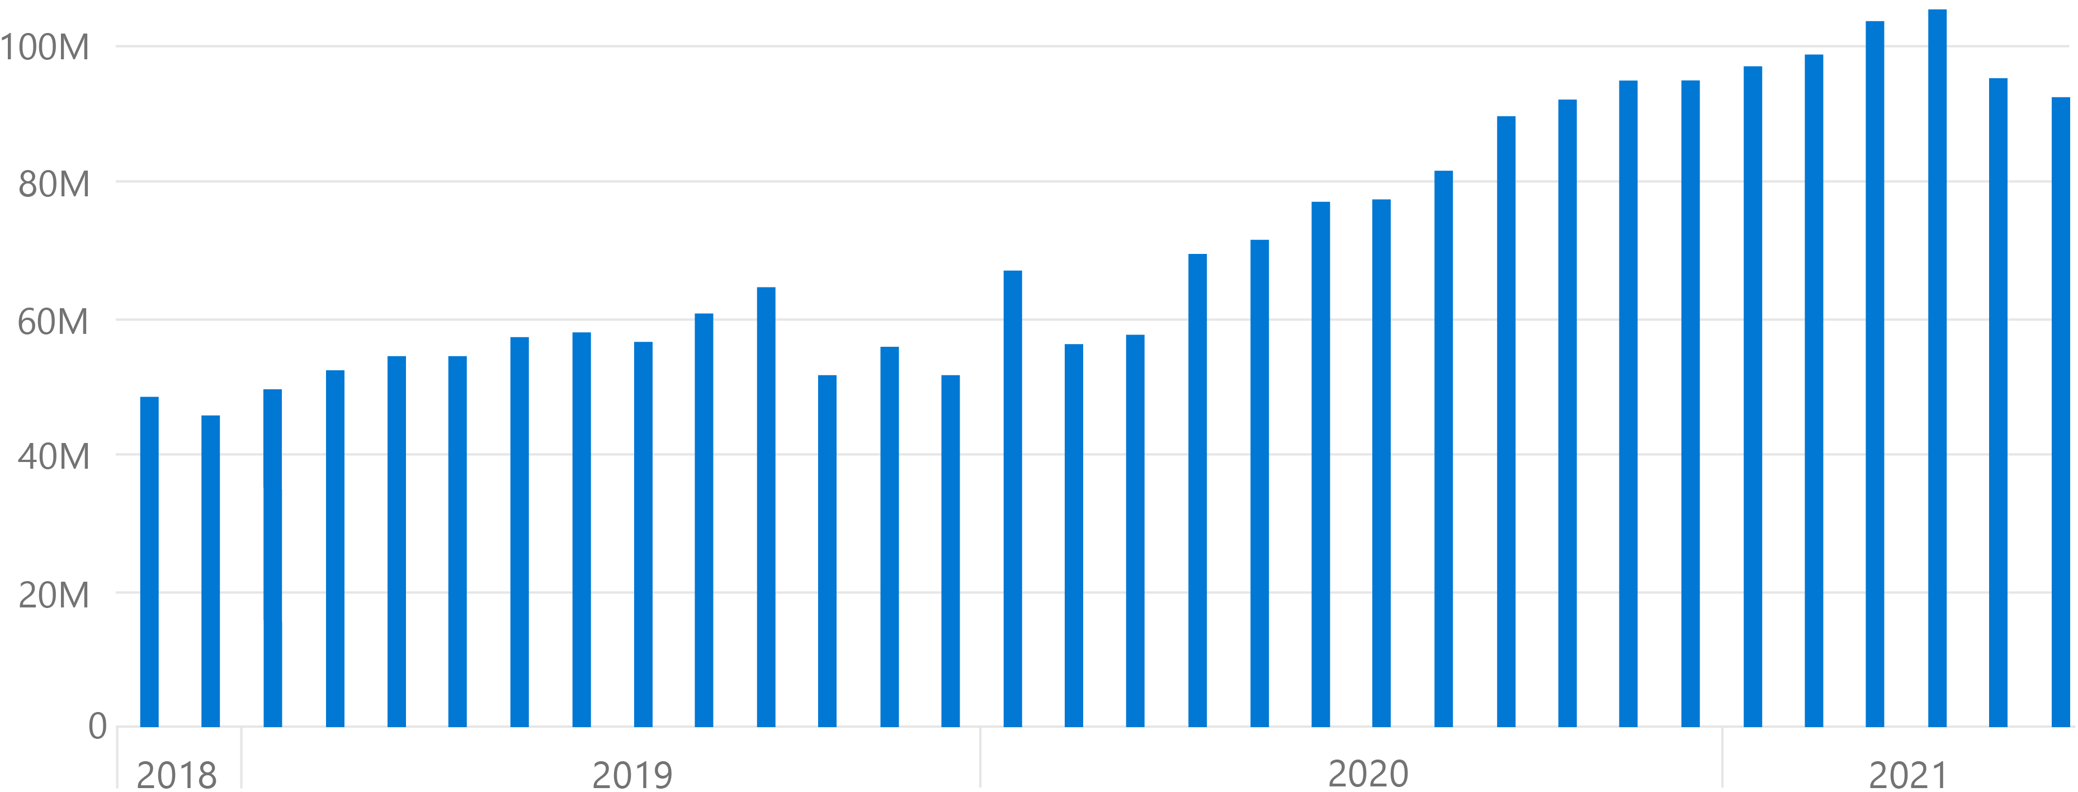
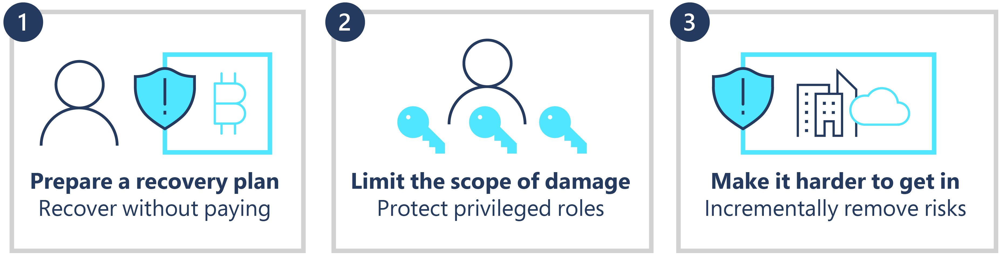
What we’re seeing in ransomware data and signals
Ransomware encounter rate (machine count): Enterprise customers (Defender data)
DART ransomware engagements by industry (July 2020-June 2021)
Overall increase in ransomware encounters, with notable surge to consumer and commercial encounters in late 2019,6 when RaaS started to grow, and in early 2020 at the onset of the COVID-19 pandemic.
Deploy ransomware protection
The stakes have changed. There is a massive growth trajectory for ransomware and extortion.
Notes:
Chart on the left: Ransomware encounter rate by machine count
There was an overall increase in ransomware encounters, with a notable surge to consumer and commercial encounters in late 2019, when RaaS started to grow, and in early 2020 at the onset of the COVID-19 pandemic.
DART ransomware engagements
While the Colonial Pipeline ransom attack of May 2021 drew considerable public attention, our Detection and Response Team (DART) ransomware engagement data shows that the three most targeted sectors were consumer, financial, and manufacturing. Despite continued promises from ransomware actors not to attack hospitals or healthcare companies during a pandemic, healthcare remains in the top-five sectors victimized by human-operated ransomware.

Slide 8
Attackers increase use of deception to pursue national objectives
Looking back at this year:
Nation state actors appear to be increasing the scale and volume of attacks to evade detection.
Focused efforts on exposing security vulnerabilities in the supply chain.
Targeted government agencies, IGOs, NGOs, and think tanks for espionage or surveillance.
Increased reliance on remote work infrastructure gave malicious actors new vectors to target private networks.
As organizations invest in securing their accounts, the success rate attacks will decline, and detection will increase.
In response, nation state actors appear to be increasing the scale and volume of attacks to improve the likelihood of success.
Notes:
Nation state actors have largely maintained their operations at a consistent pace while creating new tactics and techniques to evade detection and increase the scale of their attacks. Major cybersecurity events, like the SolarWinds attacks by NOBELIUM and on-premises Exchange Server attacks by HAFNIUM, and attacks by multiple other actors have focused our collective attention on securing our supply chains. Nation state actors and many cybercrime operations have focused efforts on exposing security vulnerabilities among their suppliers or discovering unpatched systems that organizations relied on for continuity of business during this unusual year.
The Microsoft Threat Intelligence Center (MSTIC) and the Digital Security Unit (DSU) have observed that most nation state actors continue to focus operations and attacks on government agencies, intergovernmental organizations (IGOs), nongovernmental organizations (NGOs), and think tanks for traditional espionage or surveillance objectives. The victims of attacks often have information relevant to an adversary government’s intelligence needs, which is why so many government agencies and think tanks are attacked.
However, private industry’s role in supporting remote workers, increased healthcare services, COVID-19 vaccine research, and COVID-19 vaccine distribution have also made them more common targets for these sophisticated actors seeking information for their government’s national security or intelligence purposes. Our increased reliance on the global telecommunications backbone and virtual private network (VPN)/virtual private server (VPS) infrastructure for remote workers gave malicious actors new vectors to gain access to targeted private networks that were scrambling to support new ways of doing business.
These sophisticated attackers continue to focus on effective techniques that help them maintain stealth and access. We have seen continuing attacks on traditional security hygiene elements as well as focus on developing and refining new, breakthrough attacks targeting the supplier ecosystem in order to attack downstream customers. However, as more organizations invest in securing their accounts, the success rate of these techniques will decline, and detection of the attacks will increase. In response, nation state actors appear to be increasing the scale and volume of these attacks to evade detection and improve the likelihood of success across multiple targets. This volume-oriented approach to compromising credentials will continue to be a useful technique if poorly secured accounts are available as targets. Attacks against unpatched third-party software or on-premises infrastructure will likely become more pervasive and become more easily exploited by nation state and cybercrime actors. Postponing installation of security updates or incomplete knowledge of deployed systems and their patch state will leave organizations vulnerable to sudden large-scale attacks as they scramble to identify affected assets and catch up to a fully patched state. Running networks with unsupported software, or software that is no longer updated, increases risk exponentially. Organizations must maintain comprehensive asset inventory, patch state awareness, and thorough backup and containment plans to be resilient against sophisticated attacks. Adversaries will continue to evolve new techniques to target and compromise corporate resources requiring a comprehensive “assume breach” mentality that extends beyond basic hygiene needs and MFA and into a holistic set of Zero Trust security principles. Applying a Zero Trust security model will become increasingly critical in protecting corporate identities, devices, applications, data, networks, and infrastructure against sophisticated threats.

Slide 9
Nation state actors discussed in this report
Notes:
Throughout this chapter, we cite examples of nation state actors to provide a deeper view into attack targets, techniques, and analysis of motivations. Microsoft identifies nation state activities by chemical element names, just some of which are shown in the following table together with the countries of origin from which the actors operate. This small sample of the total nation state actors tracked by Microsoft represents those that were most active in the last year and made most effective use of the tactics detailed in this chapter.
Microsoft also tracks and investigates many malicious activities that are either new or unknown in origin to develop a full understanding of the tactics, techniques, and objectives.
DSU Team
In the 2020 Microsoft Digital Defense Report, the Digital Security Unit threat context analysts identified common aims (espionage, disruption/destruction) and common techniques (reconnaissance, credential harvesting, malware, and virtual private network (VPN) exploits) prevalent among major nation state cyber actors. These aims and techniques were as prevalent this year as the year before. Tried-and-true methods such as large-scale spear-phishing campaigns were still valuable tools in the kits of hackers. However, attackers worldwide, either affiliated directly with governments or with more loose connections, are continuing to perform research against targets in order to be more convincing in an attack, develop new techniques that have not been seen before, or even mimic criminal behavior in an attempt to obfuscate intent and objective. Microsoft responds by also working to improve our ability to keep up with the changes.
Espionage more prevalent than destructive attacks
The two main goals of nation state actors have not changed either. In the last year, espionage, and more specifically, intelligence collection, has been a far more common goal than destructive attacks. Iran has been the only nation state actor willing to regularly engage in destructive attacks, mostly against Israel. These cyberattacks happened within a political environment in which both countries were trading blows just short of military strikes, including attacks on one another’s cargo ships. With tensions already so high, the decision to use cyber for destructive attacks was less of a strategic leap for Iran than it would have been for North Korea, Russia, or China. While nations other than Iran mostly refrained from destructive attacks, they did continue to compromise victims that would be prime candidates for destructive attacks if tensions increased to the point where governments made strategic decisions to escalate cyber warfare.
The “most targeted sectors” chart in this chapter shows that nearly 80% of those targeted were either in government, NGOs, or think tanks. Think tanks often serve as policy incubators and implementers, with strong ties to current and former government officials and programs. Threat actors can and do exploit the connections between the more traditional NGO community and government organizations to position themselves to gain insights into national policy plans and intentions. As noted, it’s the think tanks with ideas relevant to current or future government policy or political objectives that put these organizations into the line of sight for intelligence operations. When traditional NGOs have similar information, we also see them as an objective for nation state actors.
Nation state actors from North Korea added a third motive to their cyberattacks: monetary gain. North Korea targets companies in cryptocurrency trade or related research, likely seeking either to steal cryptocurrency or intellectual property. North Korea’s economy is never strong, but the COVID-19 pandemic coming after years of UN sanctions has pushed it to its worst state in a generation, forcing North Korea to seek to find money by any means necessary. Although Iranian nation state actors frequently used ransomware attacks, Microsoft assesses that the ransomware was used more for covering the tracks of the attackers than for profit.
Targeting of IT companies is the big story of last year
A more revolutionary change, one common among all of the Big Four nation state cyber programs, has been the decision to target IT service providers in order to more successfully exploit victims downstream who receive services from those IT providers. The most glaring examples of the use of this kind of strategy from the last year are the Russian SolarWinds attacks and the Chinese exploitation of a vulnerability in on-premises Microsoft Exchange servers. These attacks are both covered in detail in the sections on Russia and China.
Although SolarWinds and the Exchange vulnerability were the two main cybersecurity stories of the year, Iran and North Korea also used similar tactics of targeting IT providers to find creative ways to exploit their real targets. For example, North Korean actor ZINC created online personas of apparent cybersecurity experts, including websites and social media pages, and used these personas to approach experts in cybersecurity vulnerabilities in an attempt to get the researchers they corresponded with to open content that would have downloaded exploits onto their machines. While this was not a direct attack on an IT company like SolarWinds, it did represent an attempt to indirectly find avenues to compromise North Korea’s actual targets by going through the experts responsible for finding ways to protect them.

Slide 10






Build an extensible platform
Covering multiple clouds and on-prem (hybrid)
Simplify
Trusted Digital Fabric
Integrate
Identity and access management
Information protection and governance
Compliance management
Threat protection
Automate
Cloud security
Risk management
Be Elastic

Slide 11
Microsoft Security Technology
Identity and access management
Secure access for a connected world
Threat protection
Stop threats across your entire organization
Cloud security
Comprehensive protection for multi-cloud resources, apps and data
Information protection and governance
Safeguard sensitive data across clouds, apps, and endpoints
Risk management
Identify and remediate critical data risks within your organization
Compliance management
Assess compliance and respond to regulatory requirements
Notes:
Talk track:
We are committed to a more integrated, end-to-end security approach. For Microsoft, this shows up in four broad technology areas:
Identity and Access Management: The vast majority of breaches begin with compromised passwords—they are the single weakest link in most security strategies. We start with strong identity and access management to protect your resources.
Threat Protection: Our customers consistently express their deep concerns about the high volume of data and alerts as well as the increasing sophistication and impact of attacks. By prioritizing integrated and automated threat protection, we help you meet the demand for advanced security that works in the real world.
Cloud Security: As enterprises move more of their workloads to the cloud, it has never been more important to protect your multi-cloud resources. From Azure to AWS, from Slack to Salesforce, we’ve built comprehensive cloud security to help protect every layer of your resources, regardless of which cloud or cloud apps you use.
Information Protection and Governance: Our customers also tell us about the difficulties they have to holistically and consistently protect and govern their information. Sixty-four percent of organizations report that employees externally share PII and other sensitive business data without encryption.¹ We’ve made information protection a priority to protect customers’ sensitive data wherever it lives or travels—so you can work with confidence.
Risk Management: Besides external threats, risks can also come from inside of the organizations. We’ve built solutions to help prevent, investigate, and remediate both malicious and inadvertent activities within your organizations.
Compliance Management: It is daunting and time-consuming to navigate the ever-evolving compliance landscape, and we are here to help simplify compliance and reduce risk by translating complex regulatory requirements into specific recommended actions.
1. Egress + OpinionMatters survey: https://www.businesswire.com/news/home/20190221005061/en/Survey-83-Percent-U.S.-Organizations-Accidentally-Exposed

Slide 12

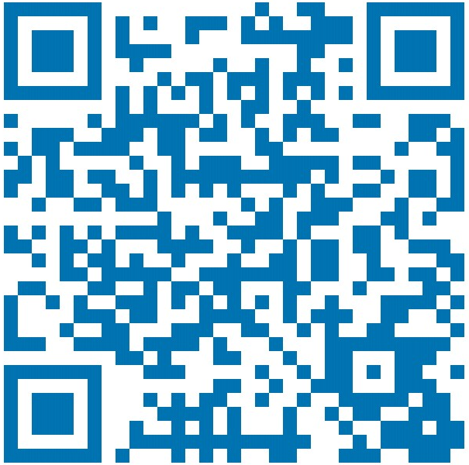
Thank you
Roger Halbheer
roger.halbheer@microsoft.com
+41 78 844 65 55

